Slide 1

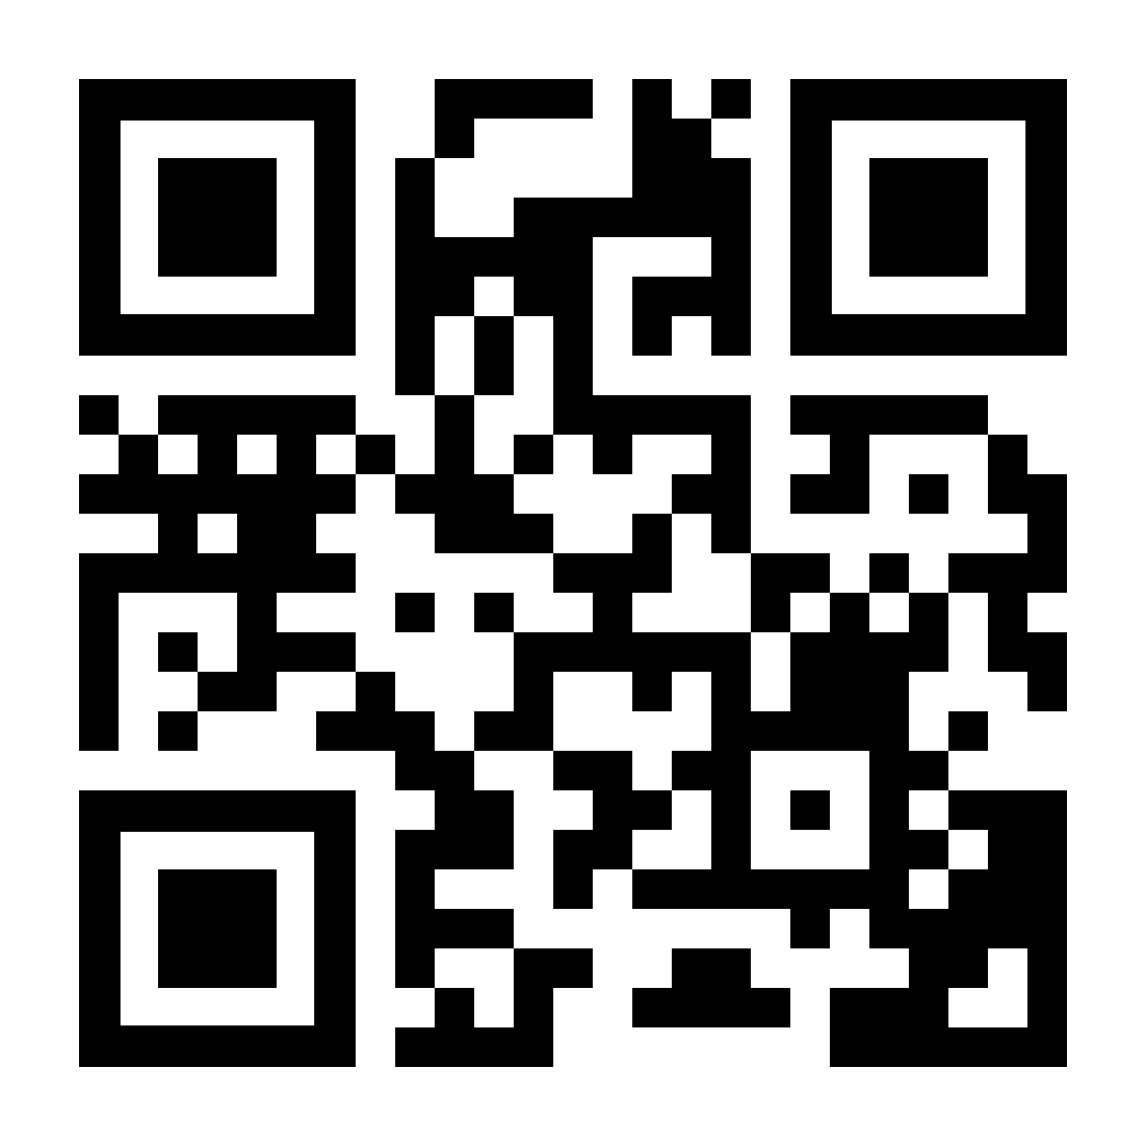
ABP Studio
The Missing Tool for .NET Developers
abp.io/studio

Slide 2

Agenda
What is ABP Studio? Why We’ve Built it?
Demo
Installation & Overview
Basics: Creating solutions / Using ABP & .NET CLI commands
Building modular & complex applications
Developing, running and monitoring distributed systems
Working with Kubernetes
Working with ABP Suite
.NET Aspire?
Road Map
Licensing
Next ABP Studio Events

Slide 3
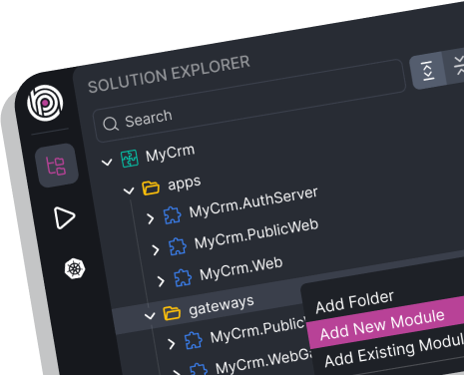
ABP Studio: What it is?
A cross-platform desktop application for ABP developers
A tool you use daily to simplify or automate your non-coding activities
It is not a coding IDE (e.g. Visual Studio)

Slide 4
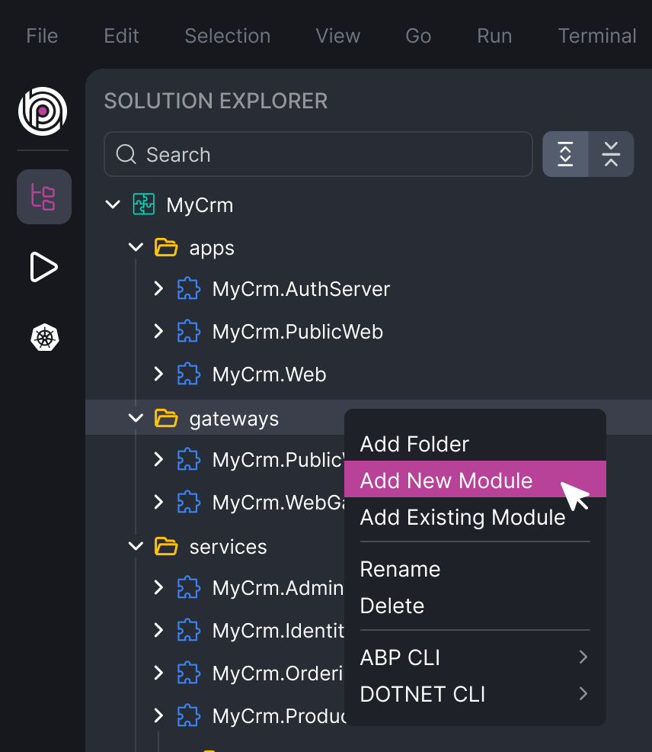
ABP Studio: Why?
A single view of a system consists of multiple .NET solutions
Architecting complex software solutions
Modular monoliths
Microservice / distributed systems

Slide 5
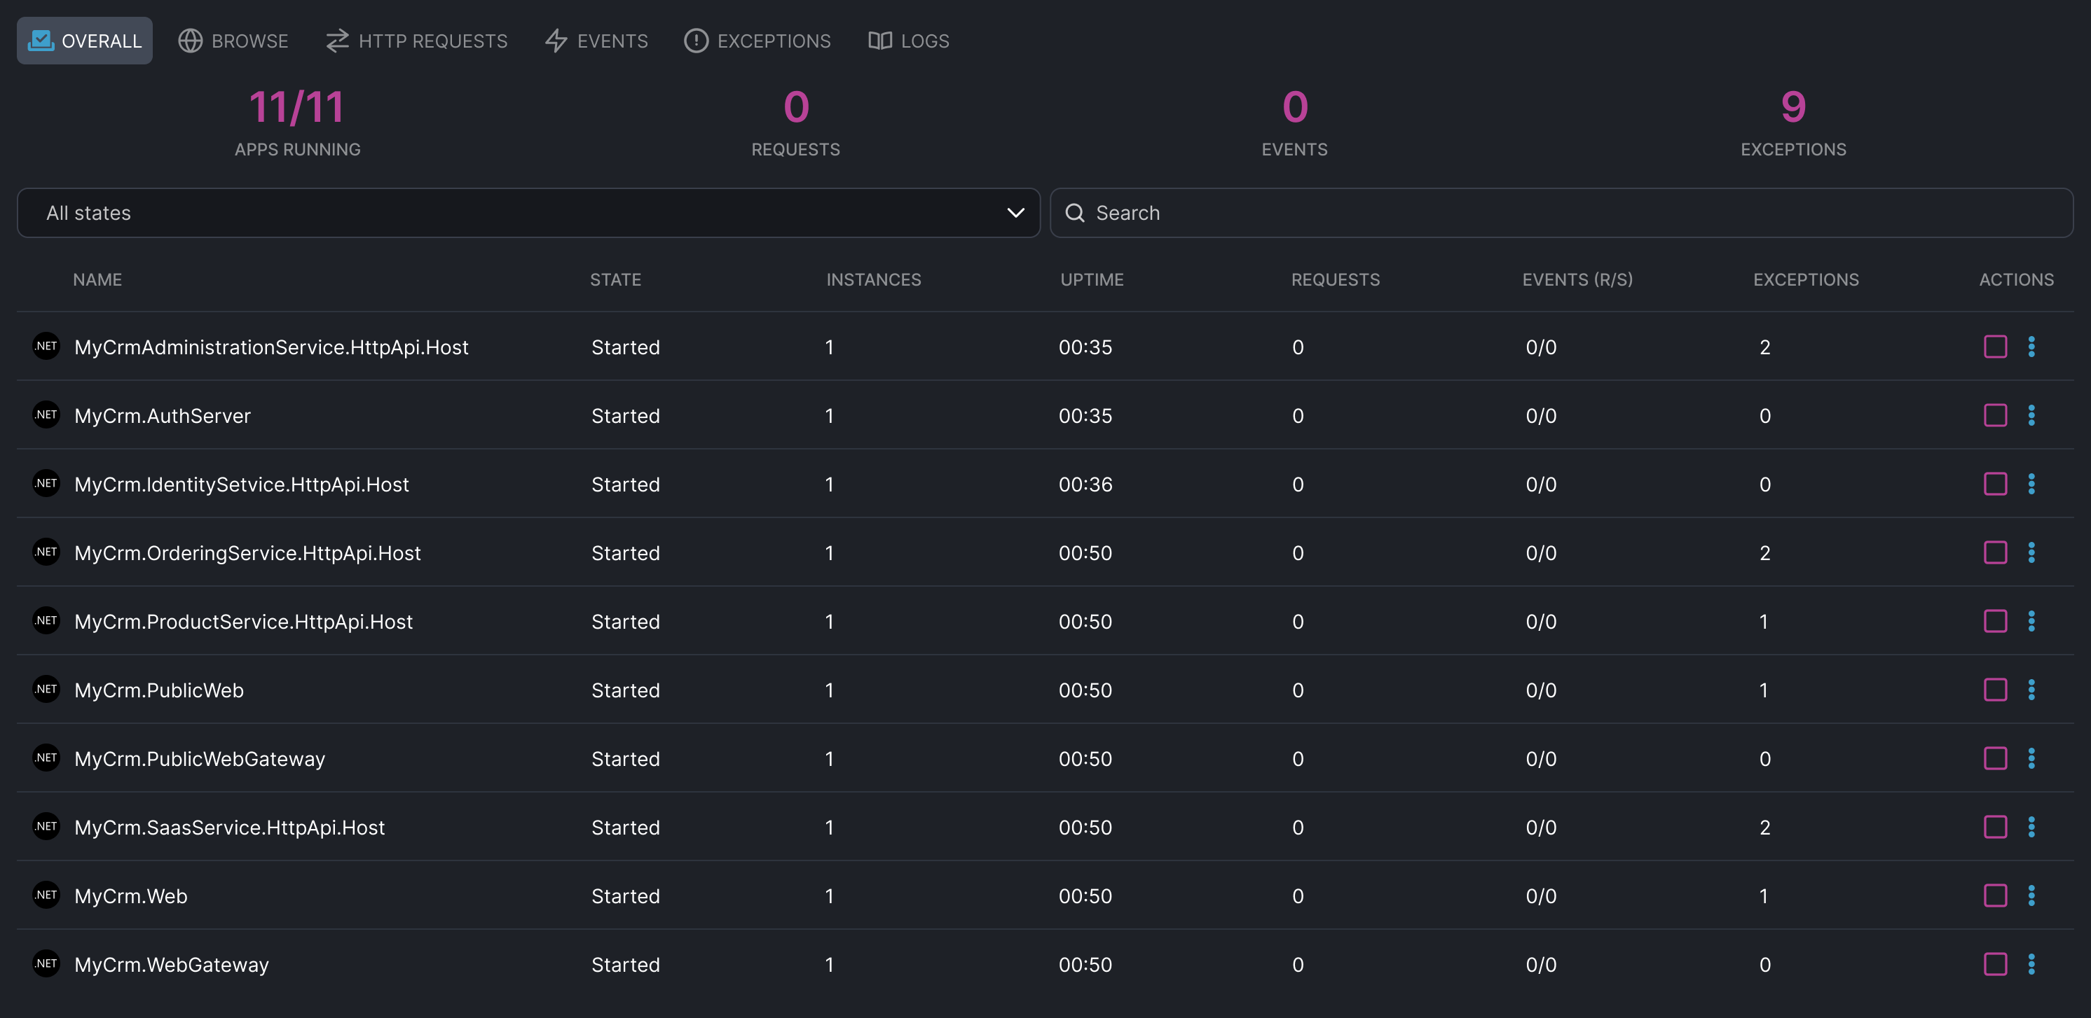
ABP Studio: Why?
A single UI to control multi-application solutions
Running multiple applications/services with a single click
Browse, monitor, trace and debug problems across applications/services

Slide 6
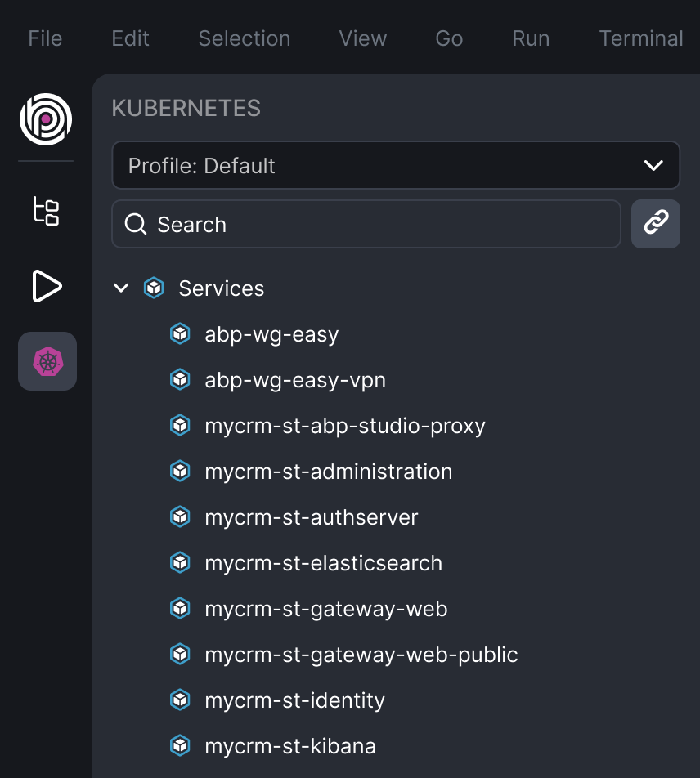
ABP Studio: Why?
A comfortable development environment for Kubernetes
Seemlessly integrate your local environment to a Kubernetes cluster
Access internal services
Intercept traffic to run, debug and develop a service in your local environment

Slide 7
DEMO

Slide 8
Creating New Solutions
The Startup Templates
Empty
Application (Single Layer)
Application (Layered)
Microservice
Options for the startup templates
Database, UI Framework, UI Theme, Optional Modules, …
Imported Modules & Dependencies
ABP & .NET CLI Commands
Running the application

Slide 9

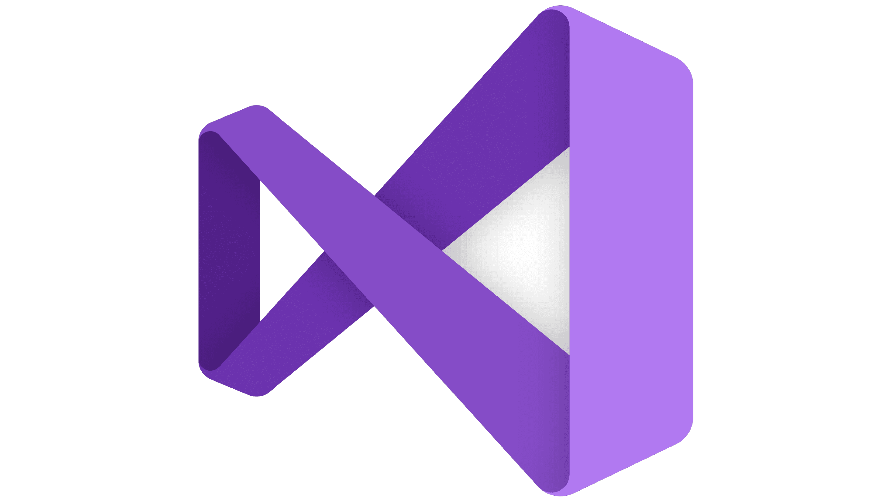

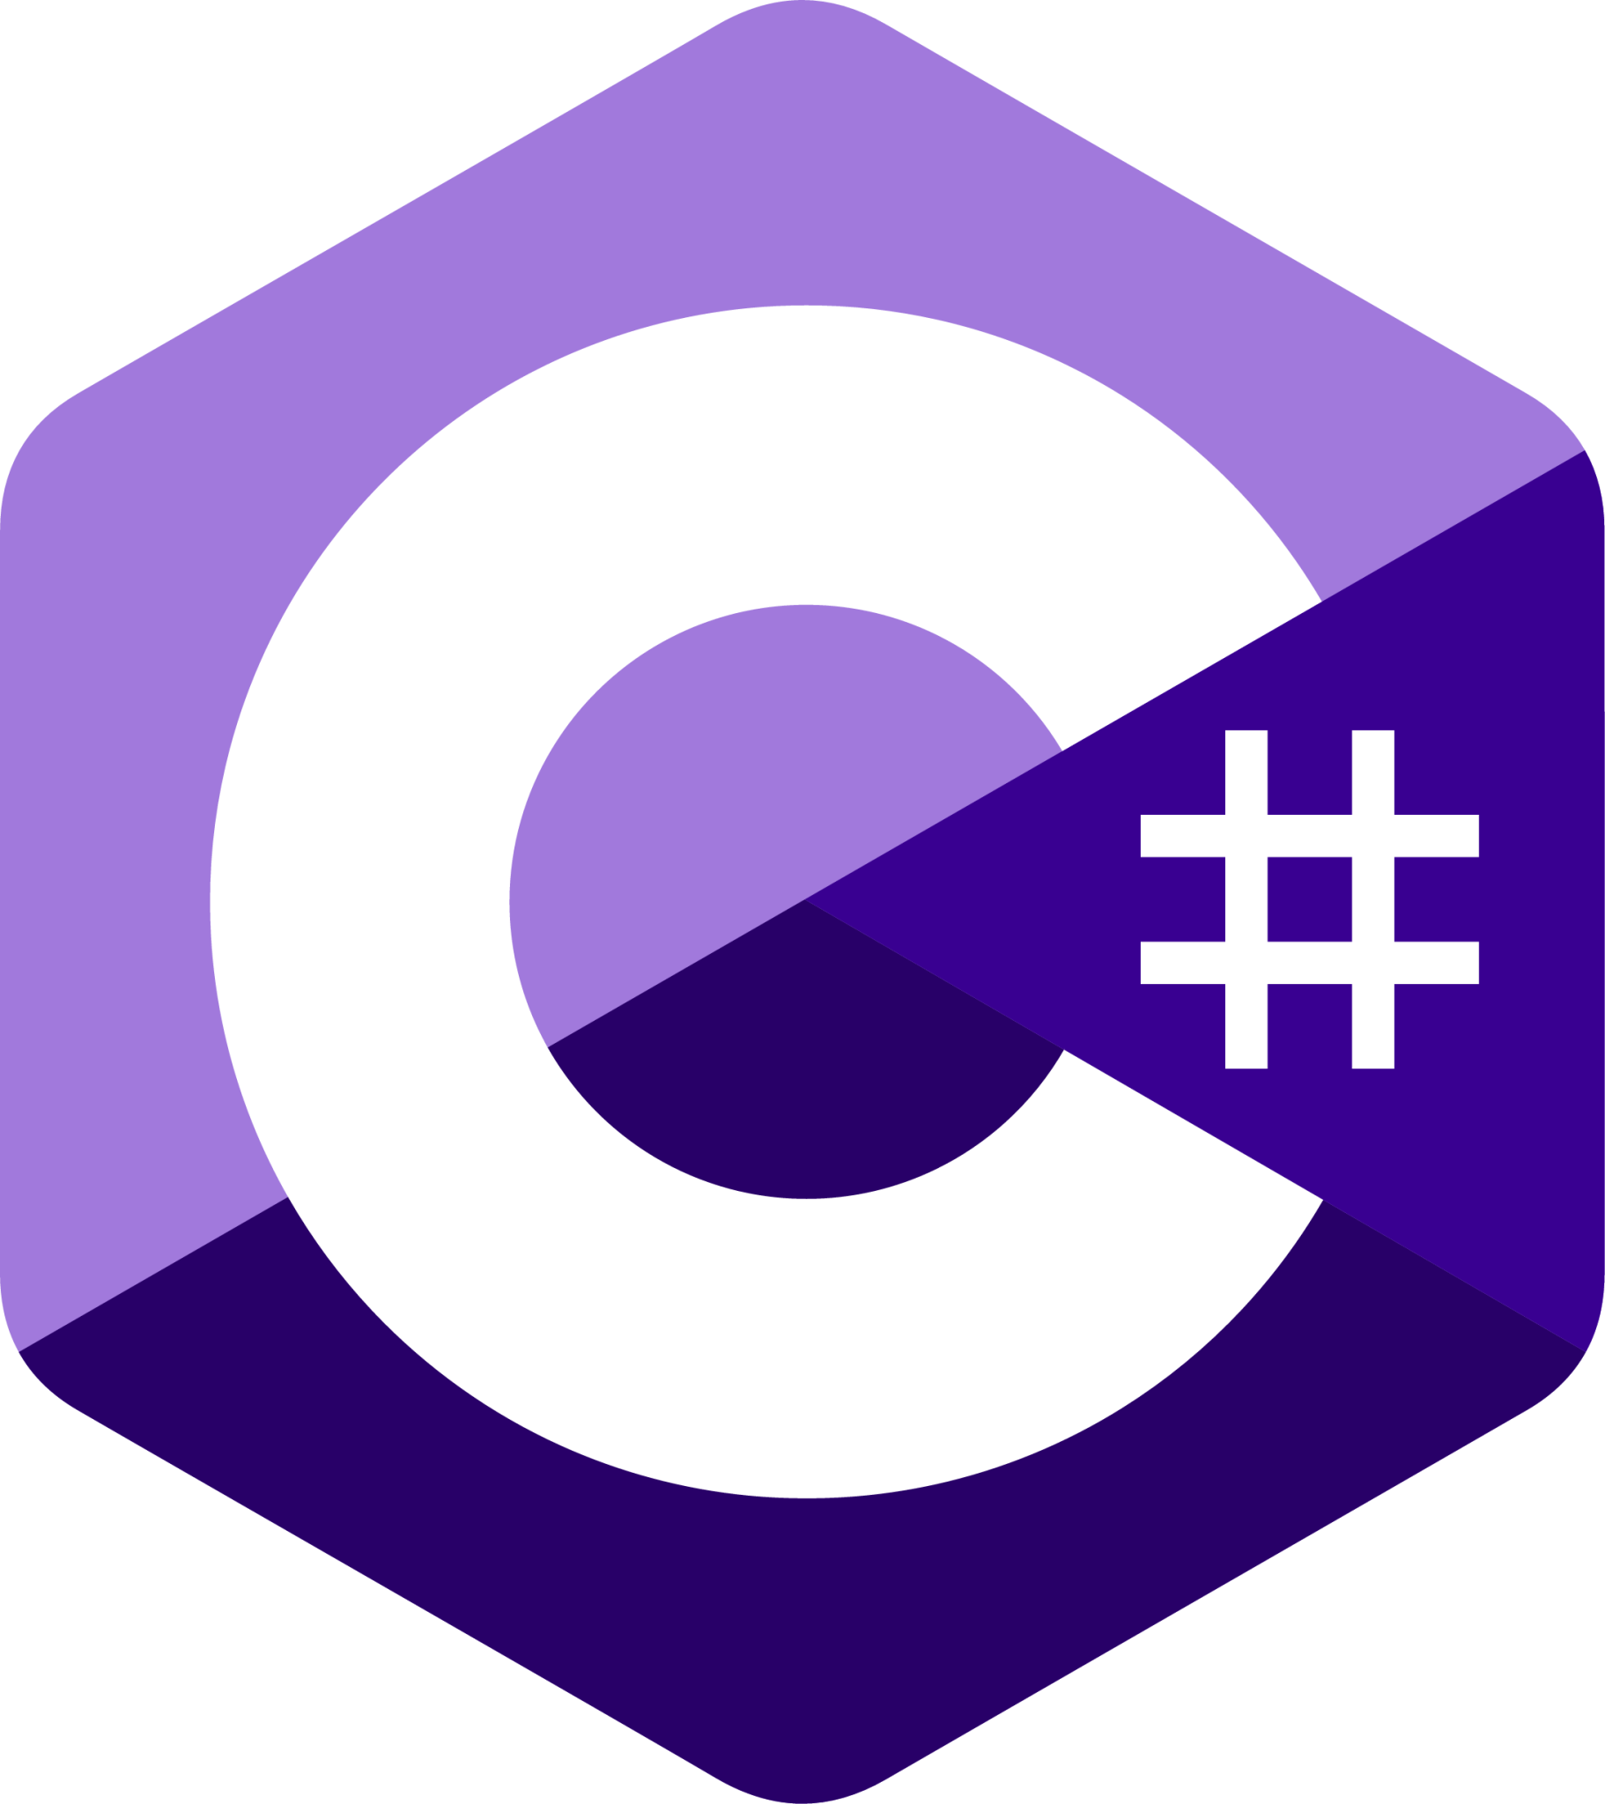

ABP Studio Main Solution Components
EasyCrm.OrderingService .NET Solution
EasyCrm.OrderingService ABP Studio Module
EasyCrm.BasketService .NET Solution
EasyCrm.BasketService ABP Studio Module
EasyCrm.CatalogService .NET Solution
EasyCrm
ABP Studio Solution
EasyCrm.CatalogService ABP Studio Module
EasyCrm.CustomerService .NET Solution
EasyCrm.CustomersService ABP Studio Module
EasyCrm.CustomerService.UI .NET Project (.csproj)
EasyCrm.CustomerService.UI ABP Studio Package

Slide 10
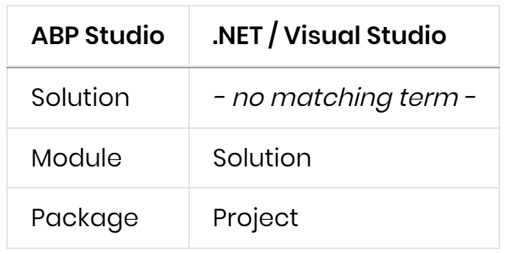
ABP Studio Main Solution Components

Slide 11
Building Modular Solutions
Installing a pre-built application module
Customizing a used module
Replacing a module with its source code
Creating new modules
DDD Module
Empty Module
Adding Package References

Slide 12
Developing, Running and Monitoring Distributed Systems
Creating & exploring a microservice solution
Running applications & services
Browsing the applications
Working with multiple profiles
Developing & debugging with the Solution Runner
Monitoring the applications and services
Overall
HTTP Requests
Distributed Events
Exceptions
Logs

Slide 13

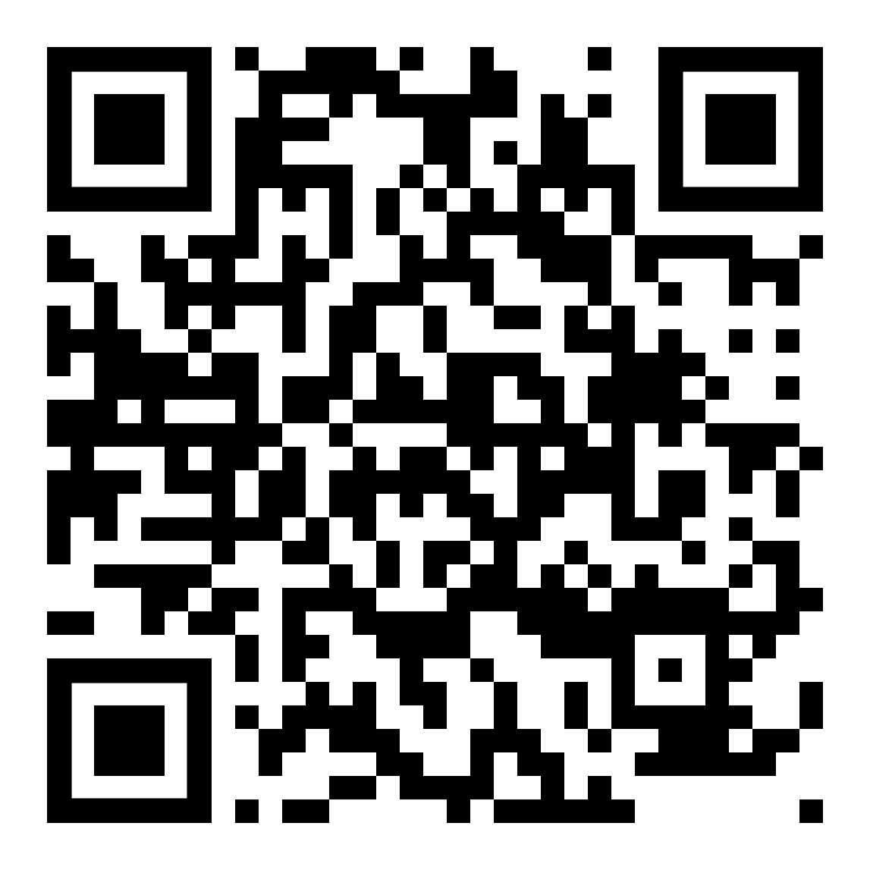
Working with Kubernetes
Kubernetes Integrated Microservice Development with ABP Studio
View & manage Helm charts
Building docker images
Installing Helm charts
Connecting to a Kubernetes cluster
Accessing to internal services
Browsing the applications
Collecting data from a Kubernetes cluster
Intercepting services
Re-deploying services

Slide 14
ABP Studio vs .NET Aspire
Feature | ABP Studio | .NET Aspire
Integration Packages (Dapr, Redis, RabbitMQ, MongoDB, etc) | YES (rich and well-integrated abstractions) with ABP Framework | YES (simple abstraction & integrations)
Starter Templates | YES (advanced architecture & options, includes K8s config, includes application modules, ready to deploy to production, ...) | YES (simple, minimal, configured for local development, far away from a real-world solution)
Monitoring | YES (HTTP Requests, Events, Exceptions, Logs) | YES (Metrics, Traces, Logs)
Application Runner (hosting) | YES (advanced) | YES (no individual start/stop, no UI)
Architecting / Building Solutions | YES | -
Kubernetes Tunneling | YES | -
Building Modular Solutions | YES | -
Many other useful features… | YES ☺ | -

Slide 15
ABP Studio: Road Map
UI Theme Builder
Customizing Re-used Application Modules
Internal & Public Module Stores
More Deployment Options
Analyzing Your Solution & Smart Best-Practice Suggestions
Rapid Application Development System
Any feature request: info@abp.io

Slide 16
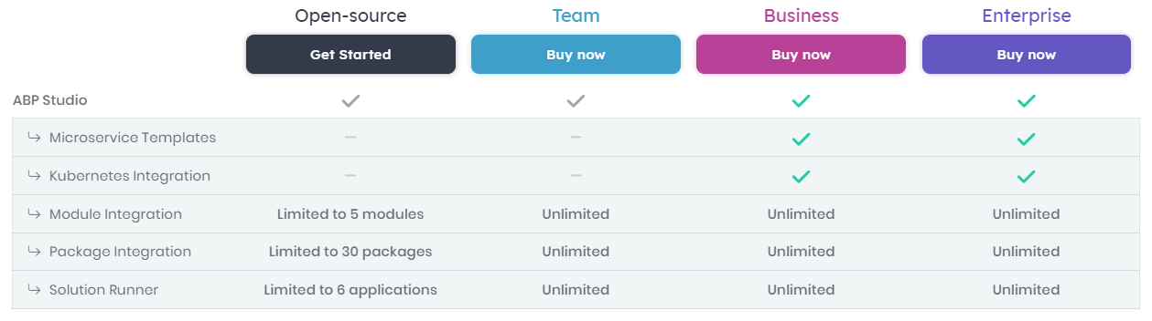
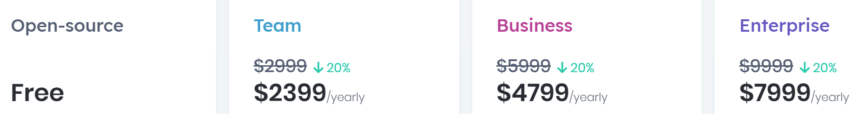
ABP Studio: Licensing
20%
Discount
https://abp.io/pricing
LAST 2 DAYS..! ☺

Slide 17
ABP Studio: Next Planned Live Events
Developing Modular Monolith Applications
Developing Microservice Applications & The Microservice Startup Template

Slide 18
? questions
abp.io/studio

Slide 19
Topic title
Content

